Slide 1
We Dive Club
Jennifer Faron
Final Project
Applications in Web Design

Slide 2
Web Site Design
I decided to base my project on scuba diving because my family and I love to dive. My parents own a diving organization called WeDive.Club where we set up dive vacations so I expanded on that idea and created a dive business website. I started designing a layout in Adobe Illustrator, then I put that into code with HTML & CSS. I love the way the website turned out. It’s functional but there’s more I’d like to do with it.

Slide 3
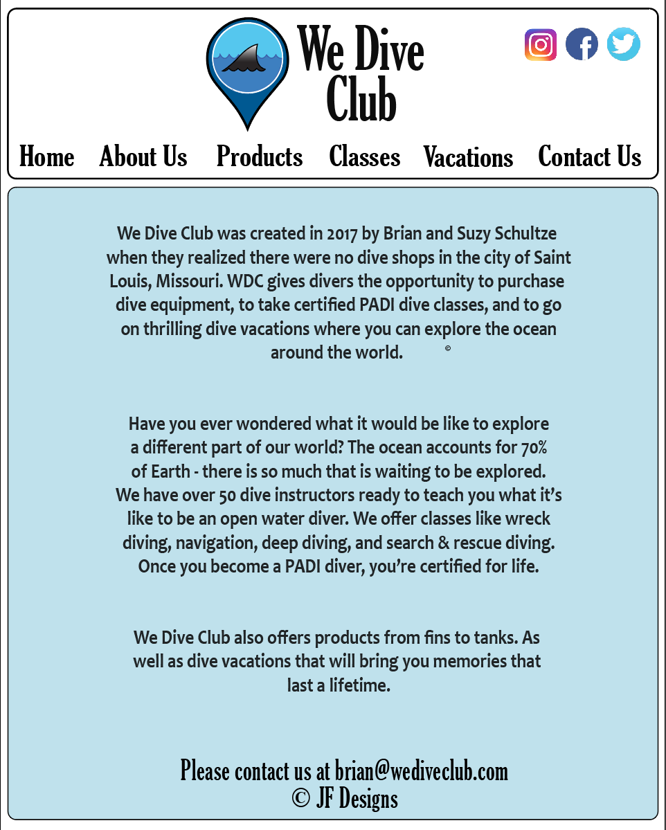
This was my home page I decided on. Something streamlined with big, bold fonts so all users would be able to read it. I created my own logo with vector art and stuck with ocean colors in shades of blue. I wanted it to look like a real website.
Once my design was created, I worked on content. The navigation panel, the about us paragraphs, and of course the MYSQL Table…

Slide 4
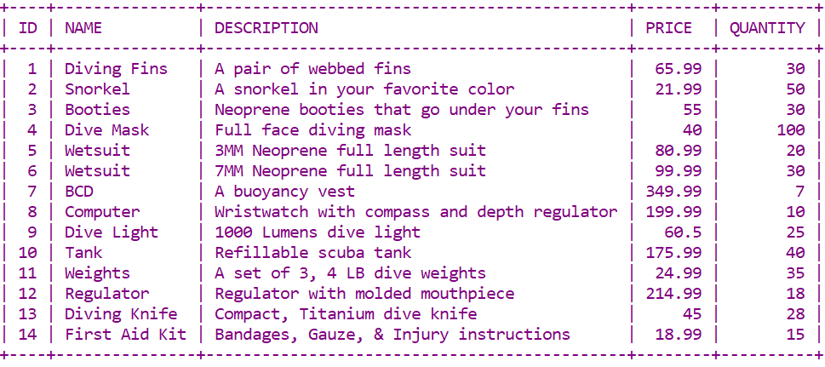
MY SQL TABLE
I created MYSQL Table in XXAMP to include different diving products. This is what I started with using INSERT INTO DIVING_PRODUCTS VALUES (…..) statements.

Slide 5
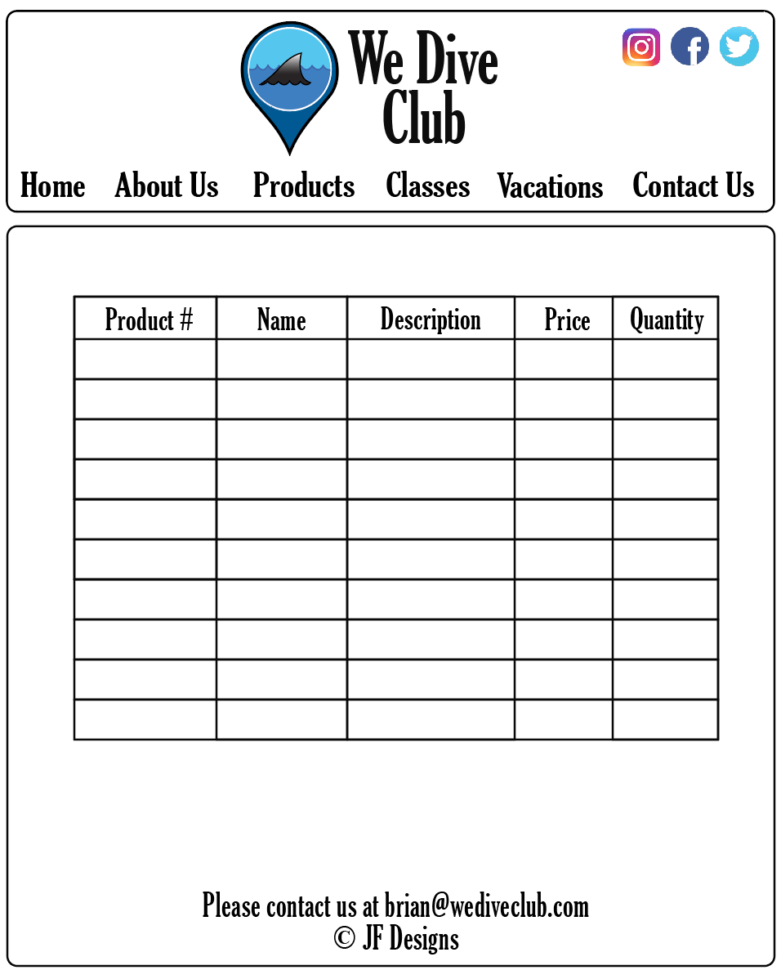
My table was going to end up on the Products tab of the web site.

Slide 6
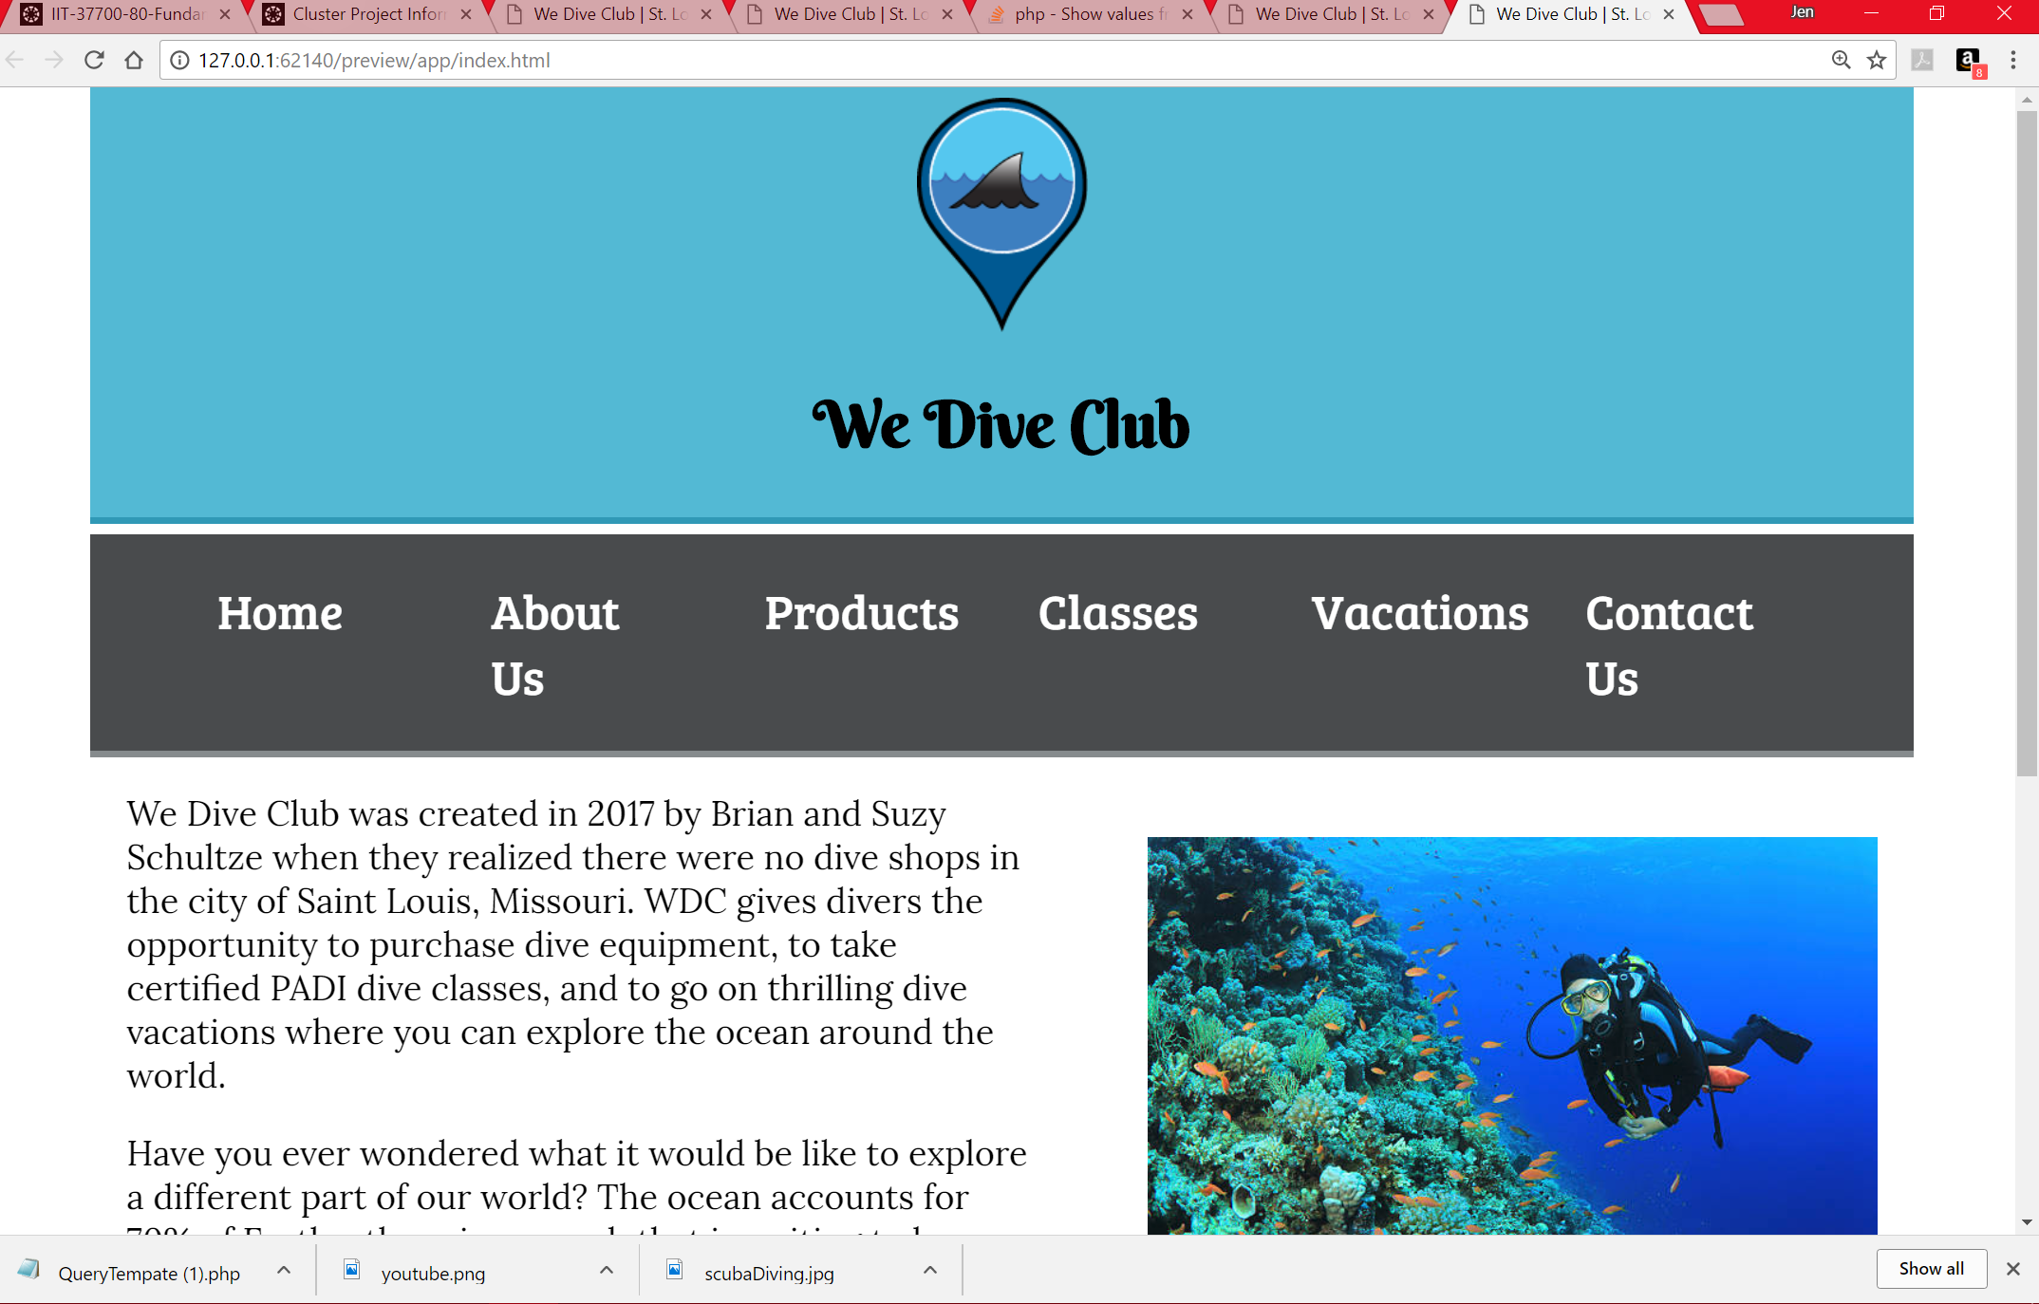
my final site:

Slide 7
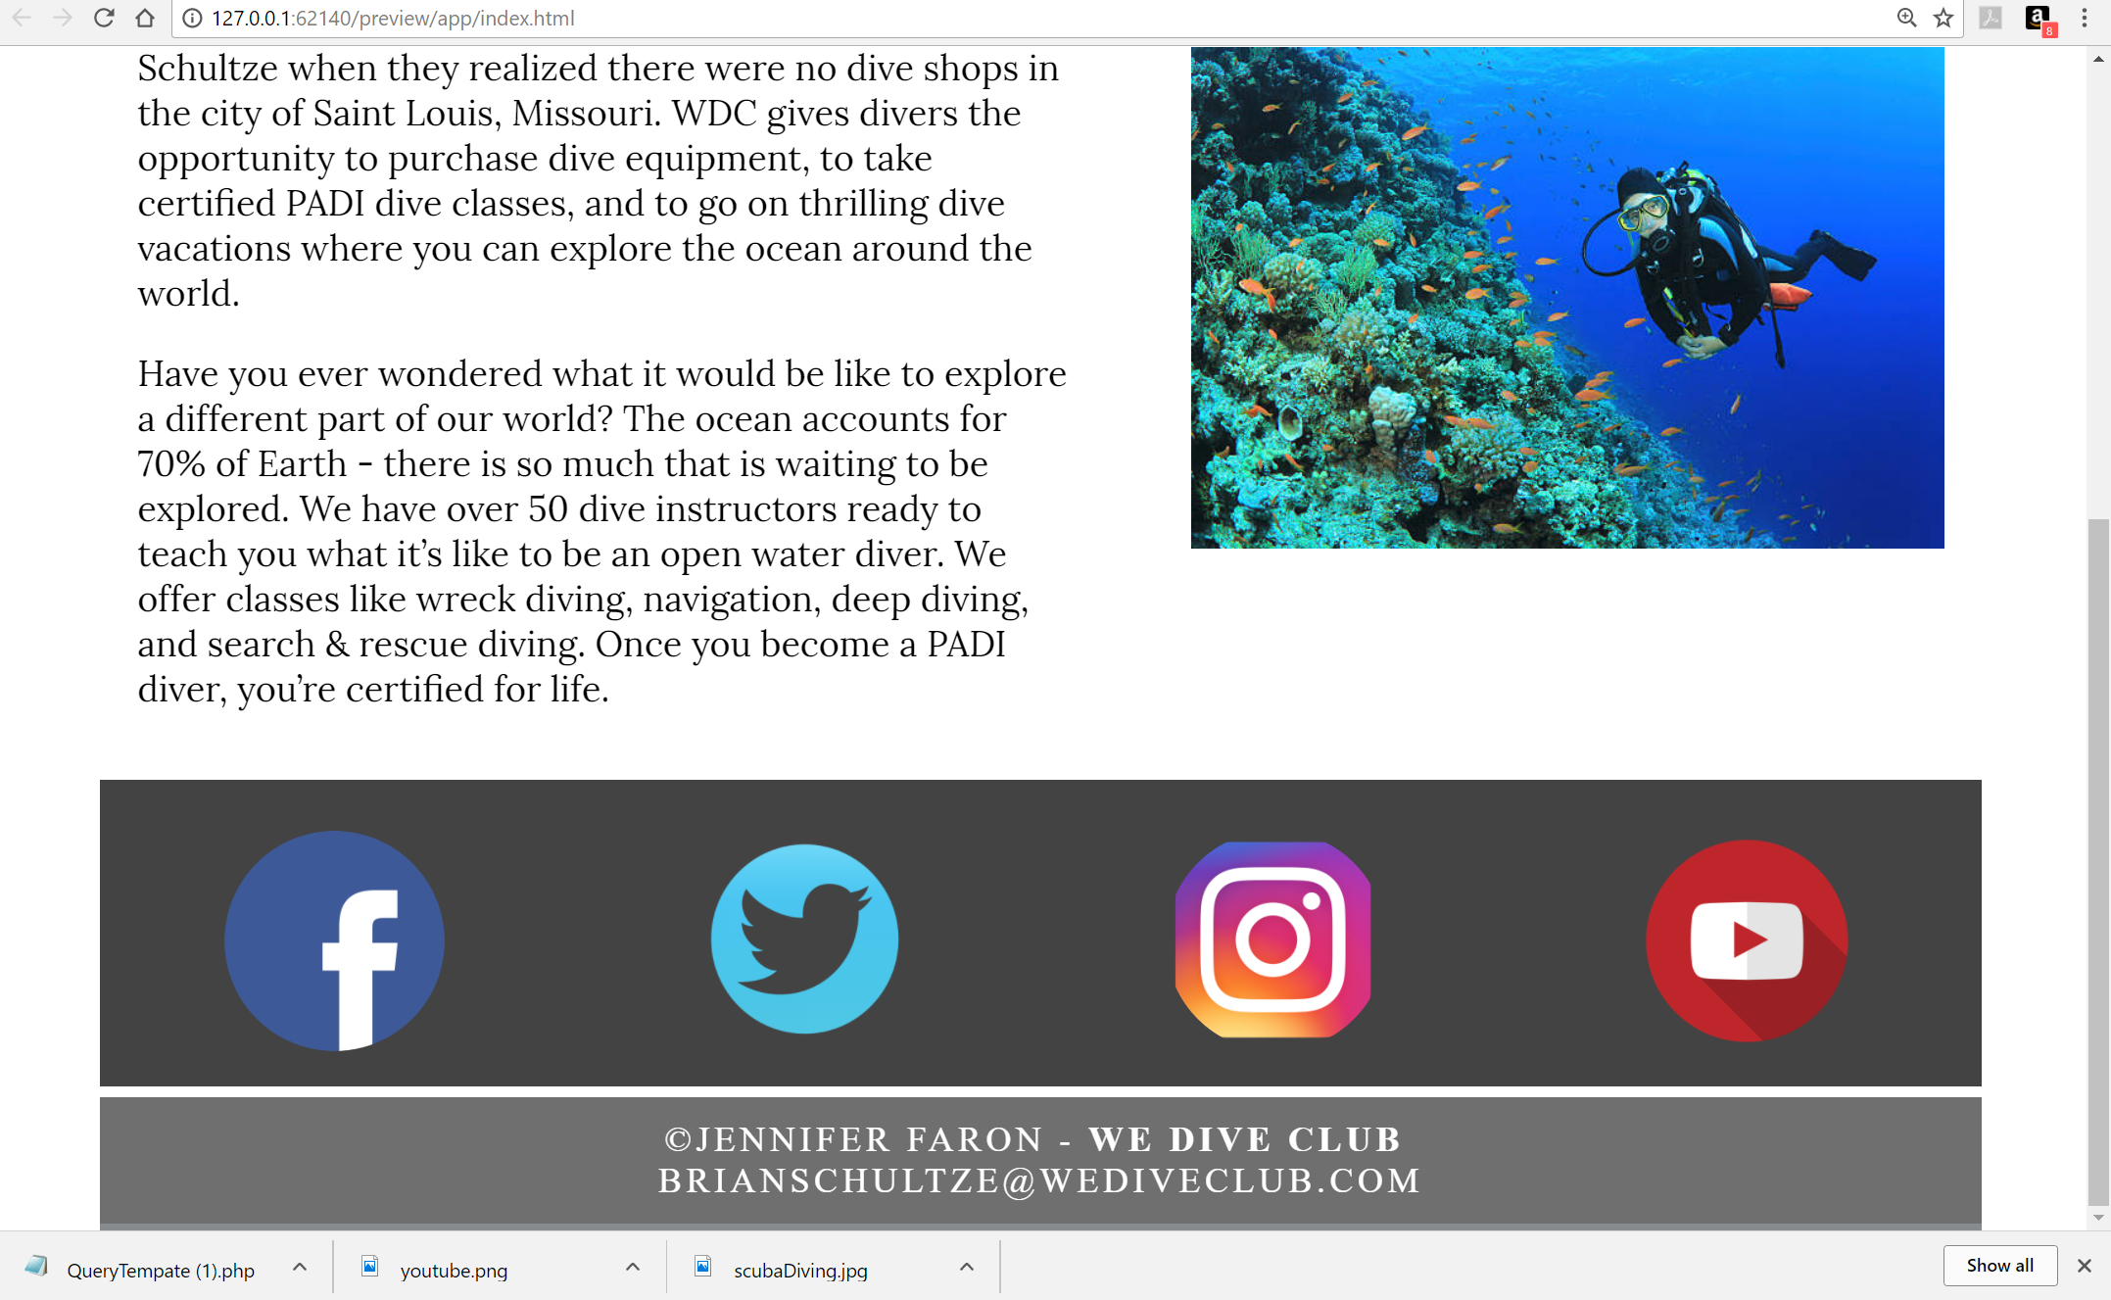

Slide 8
Coding
I started out with a simple template in Adobe Dreamweaver that had the standard HTML containers laid out. I then started with the header and navigation and worked my way down in content. I ended up changing the layout a little bit. I added social media at the bottom so it could have its own space which turned out really well. I never got to add the MYSQL table because the code was not working out. I tried using the template from class and going off the book but it didn’t work.

Slide 9
If I expanded on this site…
I’m going to add photos to the products. I will create another table in the “Classes” section where I will list out class names, descriptions, prices, and dates of the class. There will also be a spot where you can purchase the classes online as well as buy products. I’m going to create a shopping cart for the online store with MySQL running in the background. I will add a drop down list of past and upcoming vacations when you click on the “Vacations” tab. When users click on a vacation it will show them the dates of the trip, a place where they can upload photos, and a place where they can view uploaded photos in a gallery format like Facebook photos. I will also add JavaScript to make the pages more dynamic with motion on the home page. There will be a slideshow of photos beneath the home page paragraphs.

